Slide 1
VS
Vendor Sizing Template Panel
Automating product photo sizing & finishing in Photoshop
Developed by Ravindar Ramu

Slide 2
WHAT IT IS
One Click, Every Time
• Runs directly inside Photoshop (File → Scripts) — no separate app, no install
• Takes a product photo and resizes/finishes it to an exact vendor specification automatically
• One click replaces a whole manual workflow — pick an item, hit Submit, done
• Built so every one of our 100+ team members follows the exact same standardized process
100+
team members using one shared, standardized process
Developed by Ravindar Ramu

Slide 3
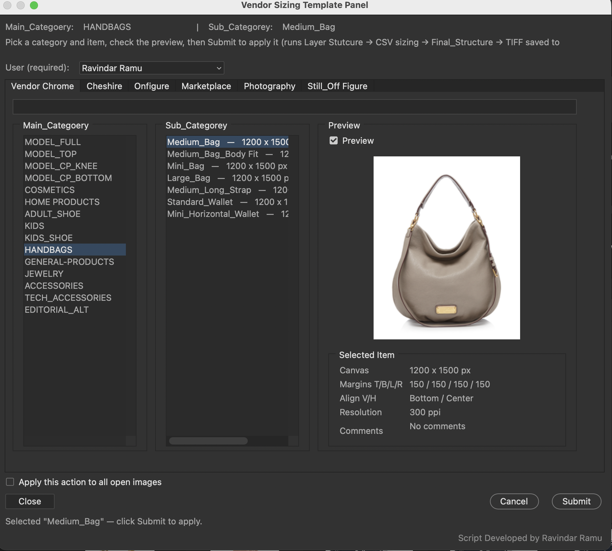
A QUICK LOOK
The Panel
Pick a category and item, preview the exact photo and target size, click Submit.

Slide 4
ORGANIZED BY TAB
Six Production Sheets
Each tab is a fully independent spec sheet — its own categories, its own sizing rules.
Vendor Chrome
Cheshire
Onfigure
The main sizing sheet — the original vendor spec
A separate production category with its own sizes
A separate production category with its own sizes
Marketplace
Photography
Still_Off Figure
Marketplace-specific sizing rules
Photography-specific sizing rules
Still / off-figure specific sizing rules
Developed by Ravindar Ramu

Slide 5
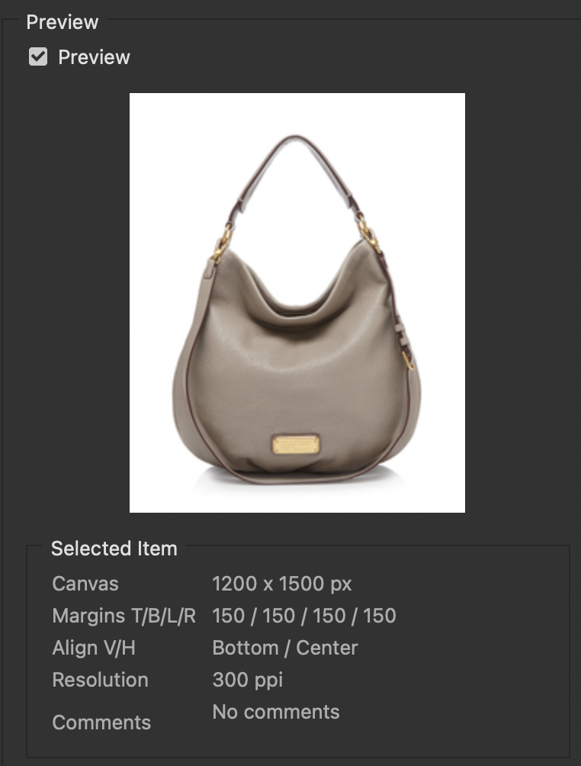
NO GUESSWORK
Live Preview & Details
Before applying anything, the operator sees:
• The exact bundled reference photo for that item
• Canvas — the precise target pixel dimensions
• Margins (Top / Bottom / Left / Right)
• Alignment — how the product sits inside those margins
• Resolution — the required output ppi
• Comments — any special instructions for that specific row
Nobody has to guess, or cross-reference a separate spec sheet.

Slide 6
FULLY AUTOMATIC
What Happens on Submit
1
2
3
4
›
›
›
Runs “Layer Stutcure” — builds the retouching structure, cuts out the subject
Scales the product proportionally — never distorted
Expands canvas to the exact target size & margins
Sets the correct resolution
5
6
7
›
›
Runs “Final_Structure” — finishing pass
Organizes & labels every layer
Saves a layered TIFF to “Completed”
Same seven steps, automatically, for every operator — every time.

Slide 7
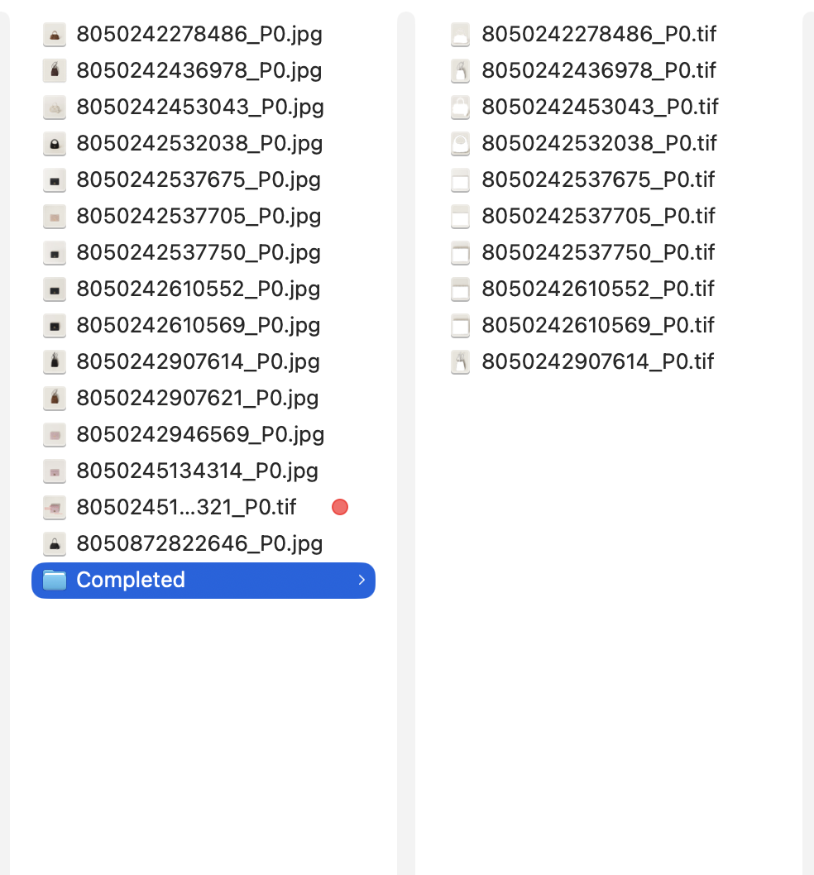
SAFETY BY DESIGN
Originals Are Never Touched
ORIGINALS
COMPLETED
The original vendor photo (left) is left completely untouched. A processed TIFF copy with the identical filename is added to a “Completed” subfolder (right). Nothing overwritten, nothing lost.

Slide 8
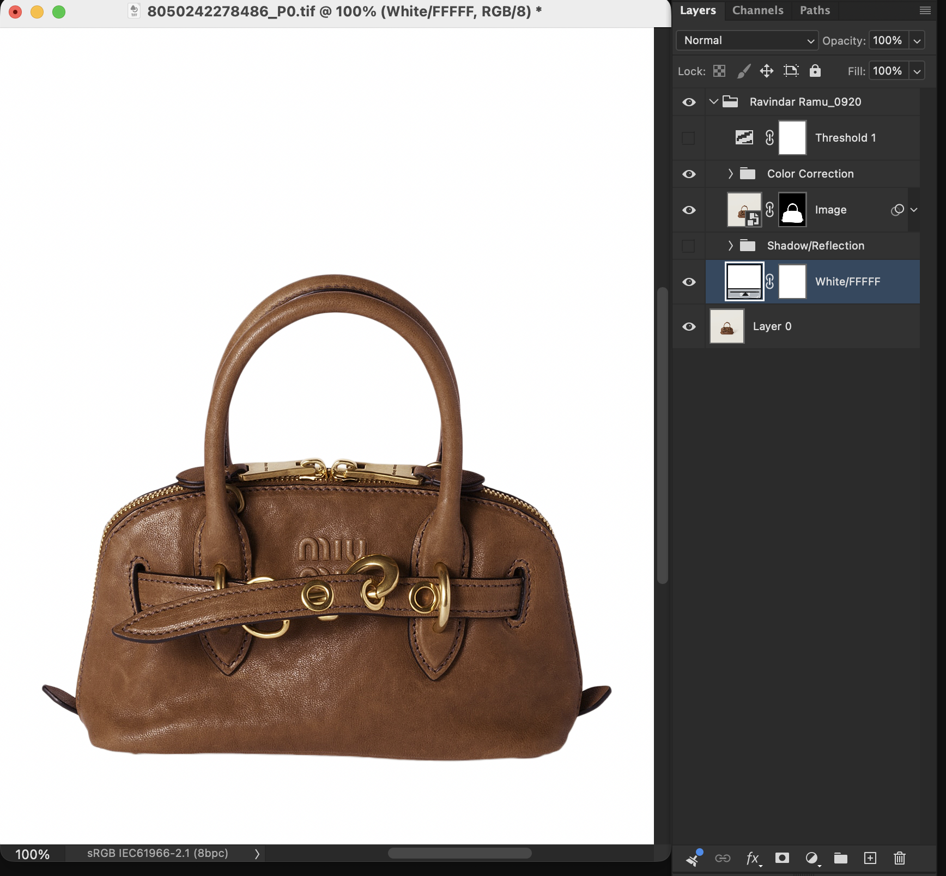
ACCOUNTABILITY
Who Processed What — and When
• Every operator picks their name from a required dropdown before Submit
• The last step renames the group to “Name_Date” — e.g. “Ravindar Ramu_0920”
• Threshold, Color Correction, Image & Shadow/Reflection all nest inside that group
• The original base layer (“Layer 0”) stays outside, kept separate
• Anyone can open a finished file and see who processed it, and when
Full traceability across the team — zero extra effort from the operator.

Slide 9

ATTRIBUTION
A Required User Selection
• Required — the Submit button stays disabled until a name is picked
• Loaded from a shared list of everyone on the team
• Remembers the last name used on that machine, so it's pre-selected next time
Developed by Ravindar Ramu

Slide 10
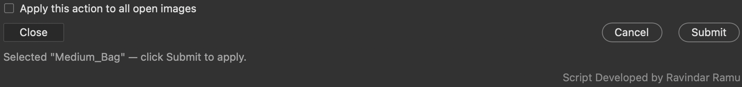
WORK FASTER
Batch Mode
• “Apply this action to all open images” processes every open image at once, with a single Submit
• No more repeating the same steps one image at a time
• Close / Cancel are always available to back out safely, before or after a selection
Developed by Ravindar Ramu

Slide 11
THE PAYOFF
Why This Matters
✓
No Errors
⏱
Time Saved
☰
Consistent & Traceable
• Margins & scale calculated automatically
• Product is never distorted
• Originals are never lost or overwritten
• Retouching structure never skipped
• A multi-step manual process is now one click
• Batch mode processes a whole folder at once
• New team members are productive immediately
• Every operator produces identically-structured output
• Every file is automatically attributed to a name and date
• One shared spec sheet for the whole team
Developed by Ravindar Ramu

Slide 12
?
Questions?
This tool is actively maintained — feedback and edge cases are always welcome.
Developed by Ravindar Ramu

